Slide 1

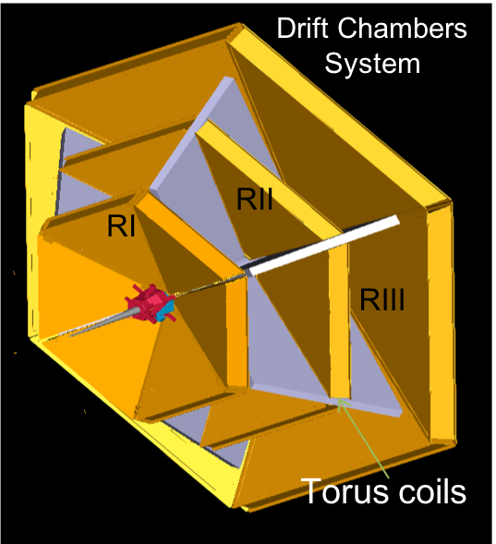


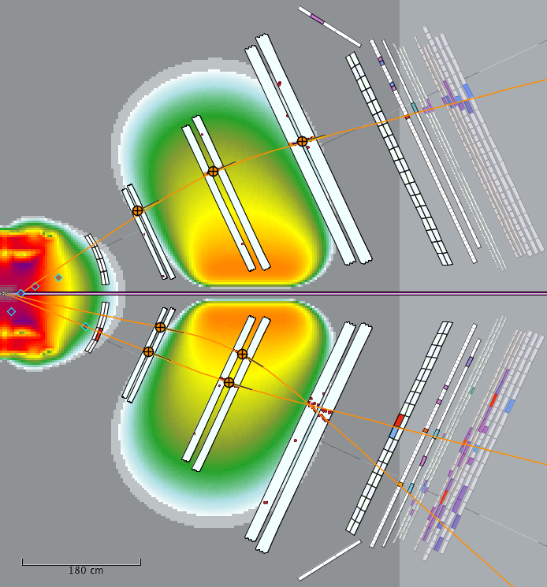
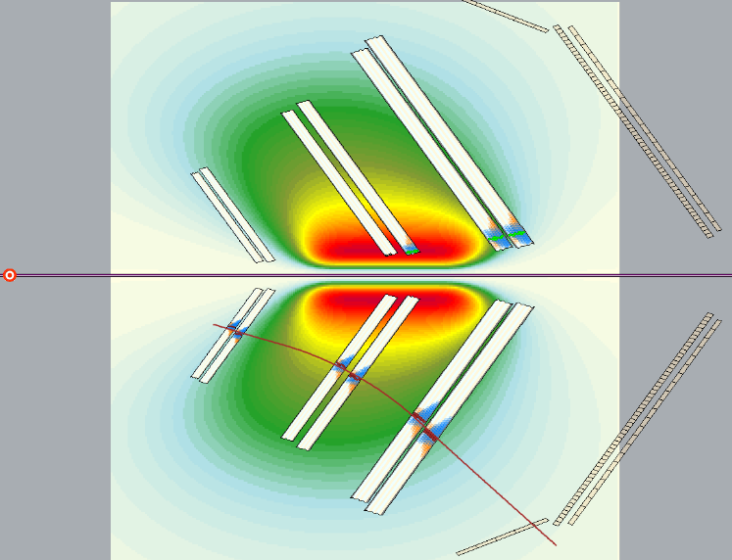
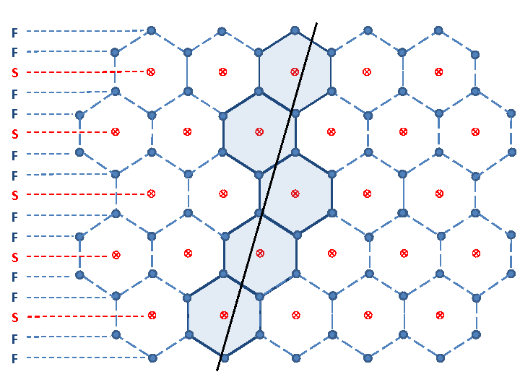
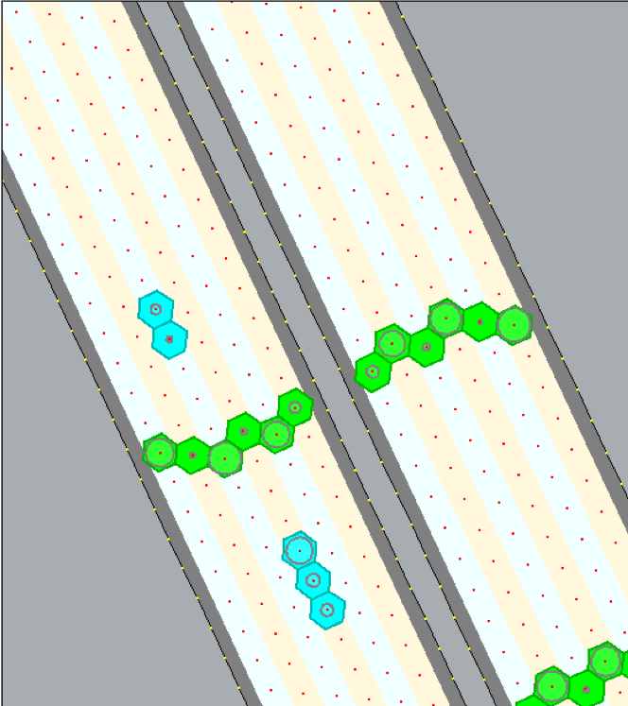
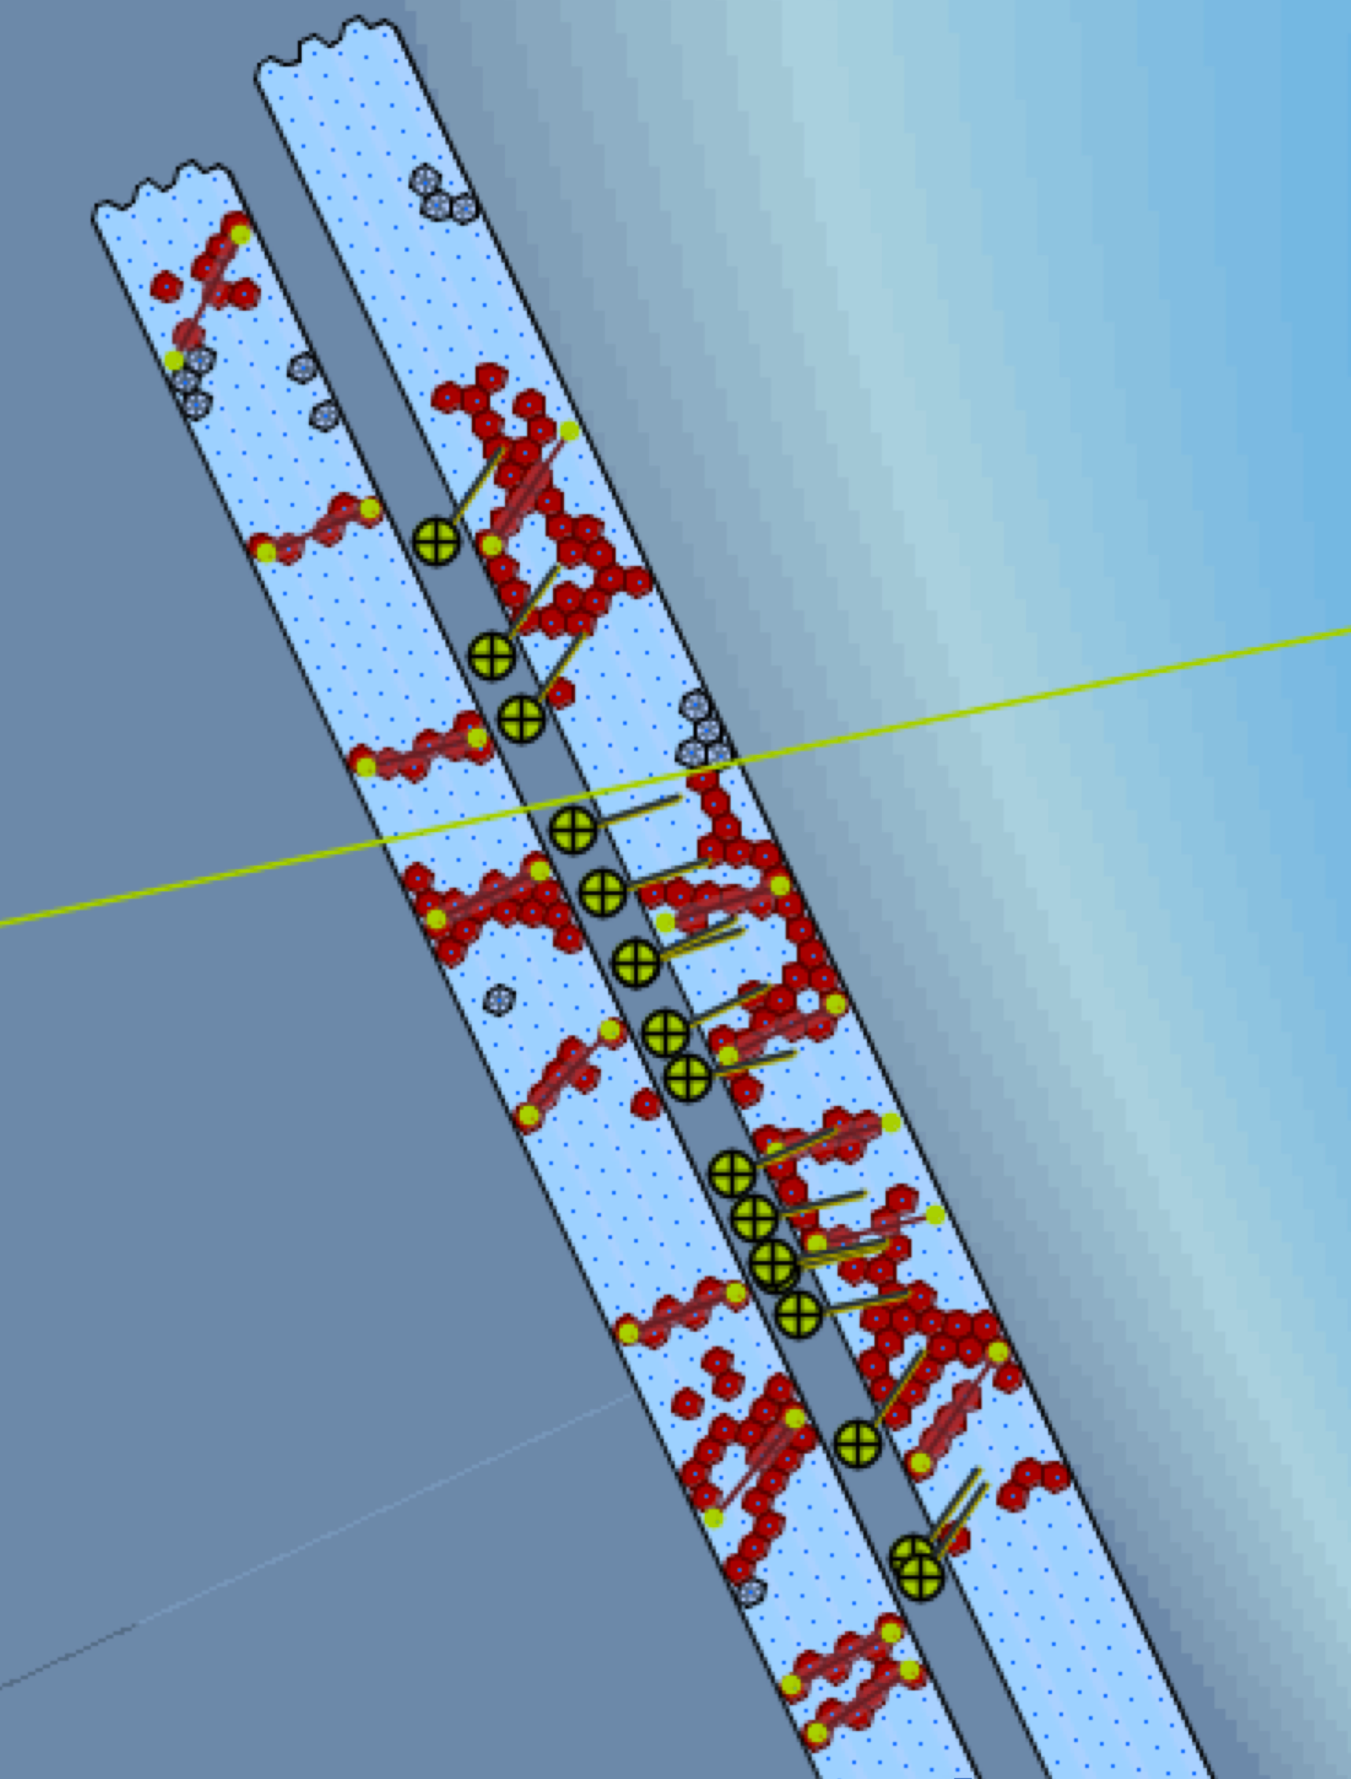
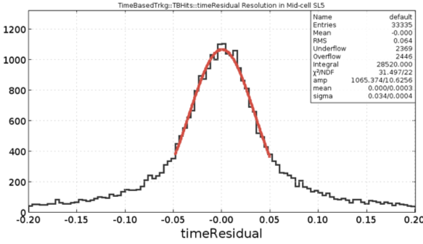
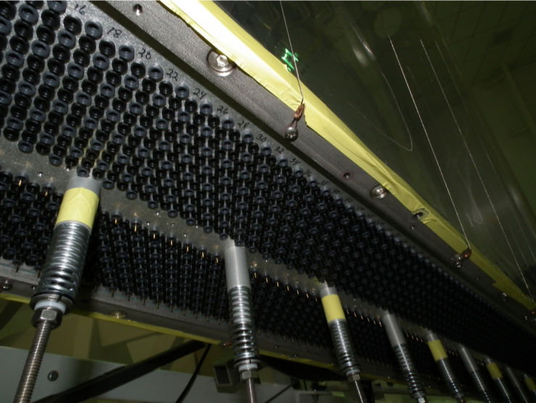
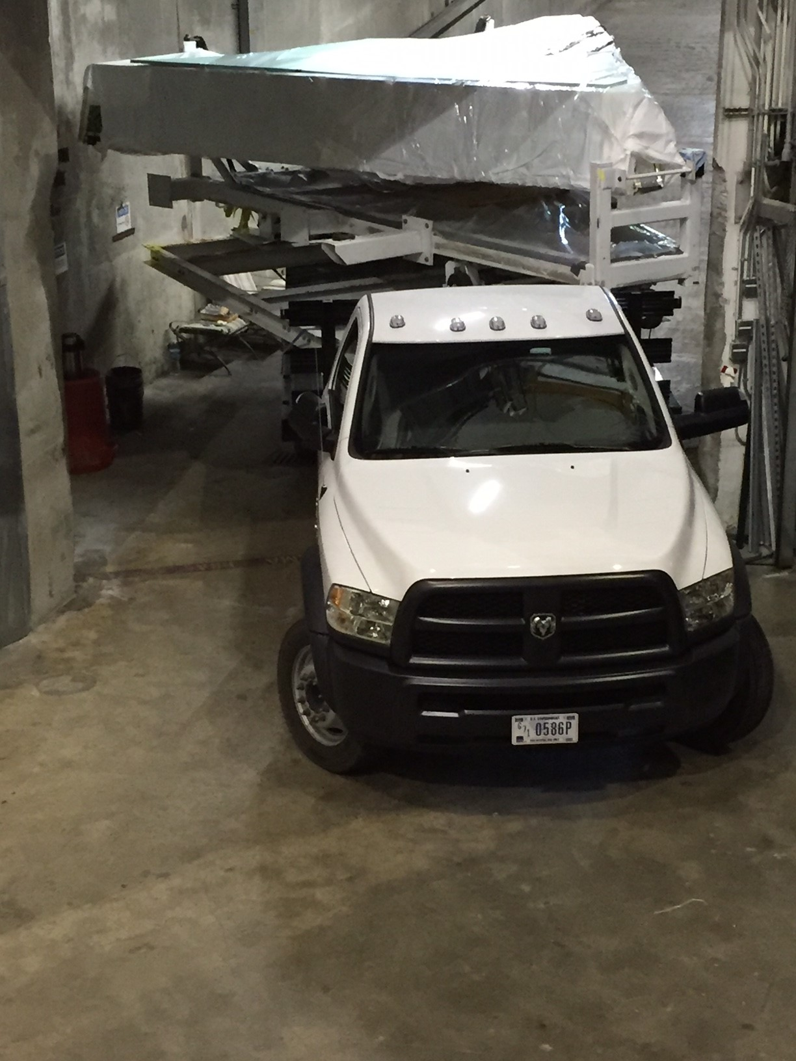
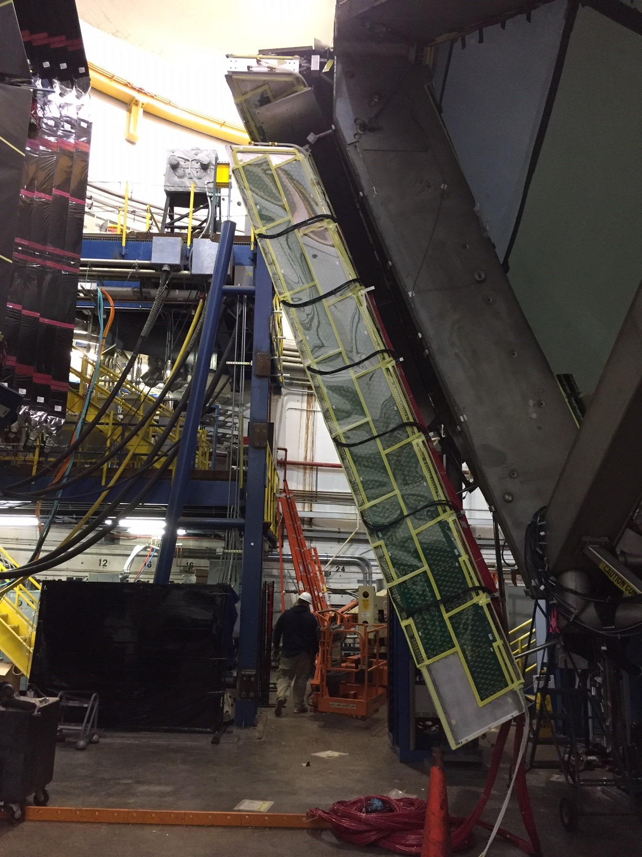
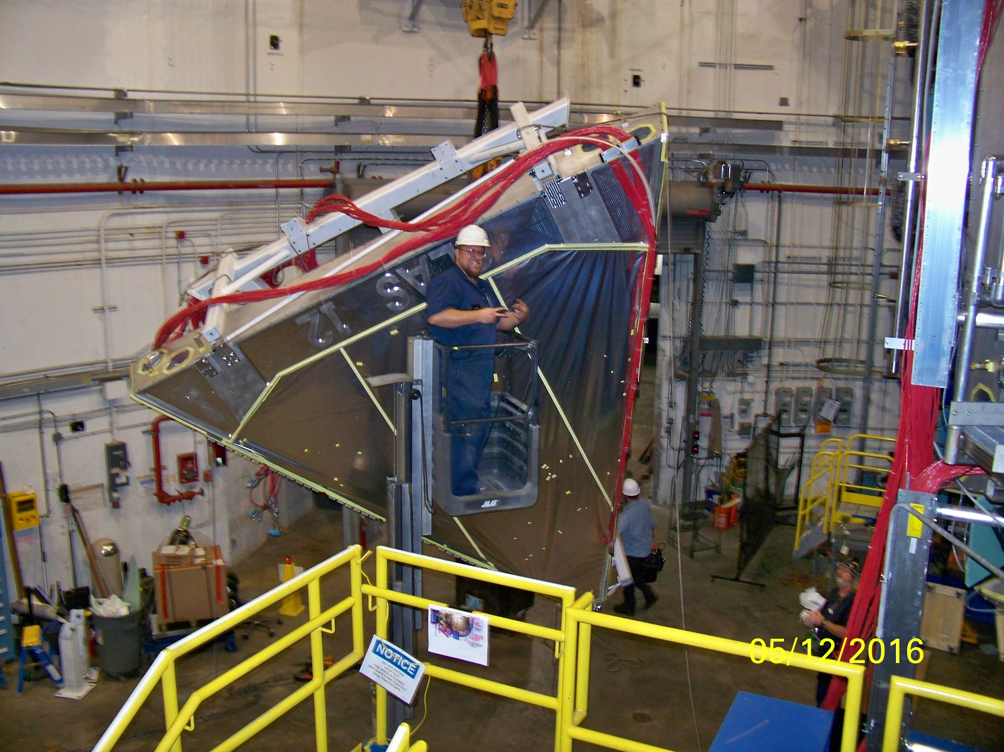
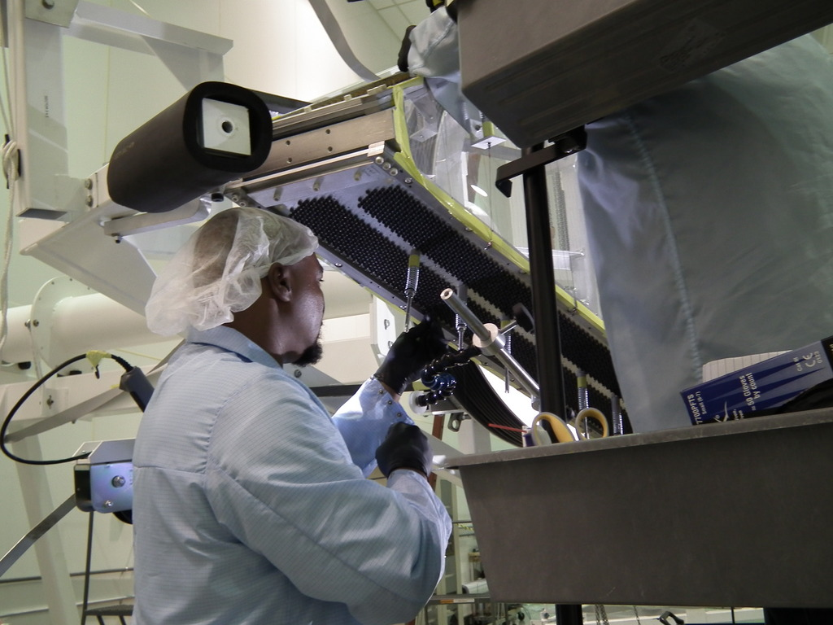
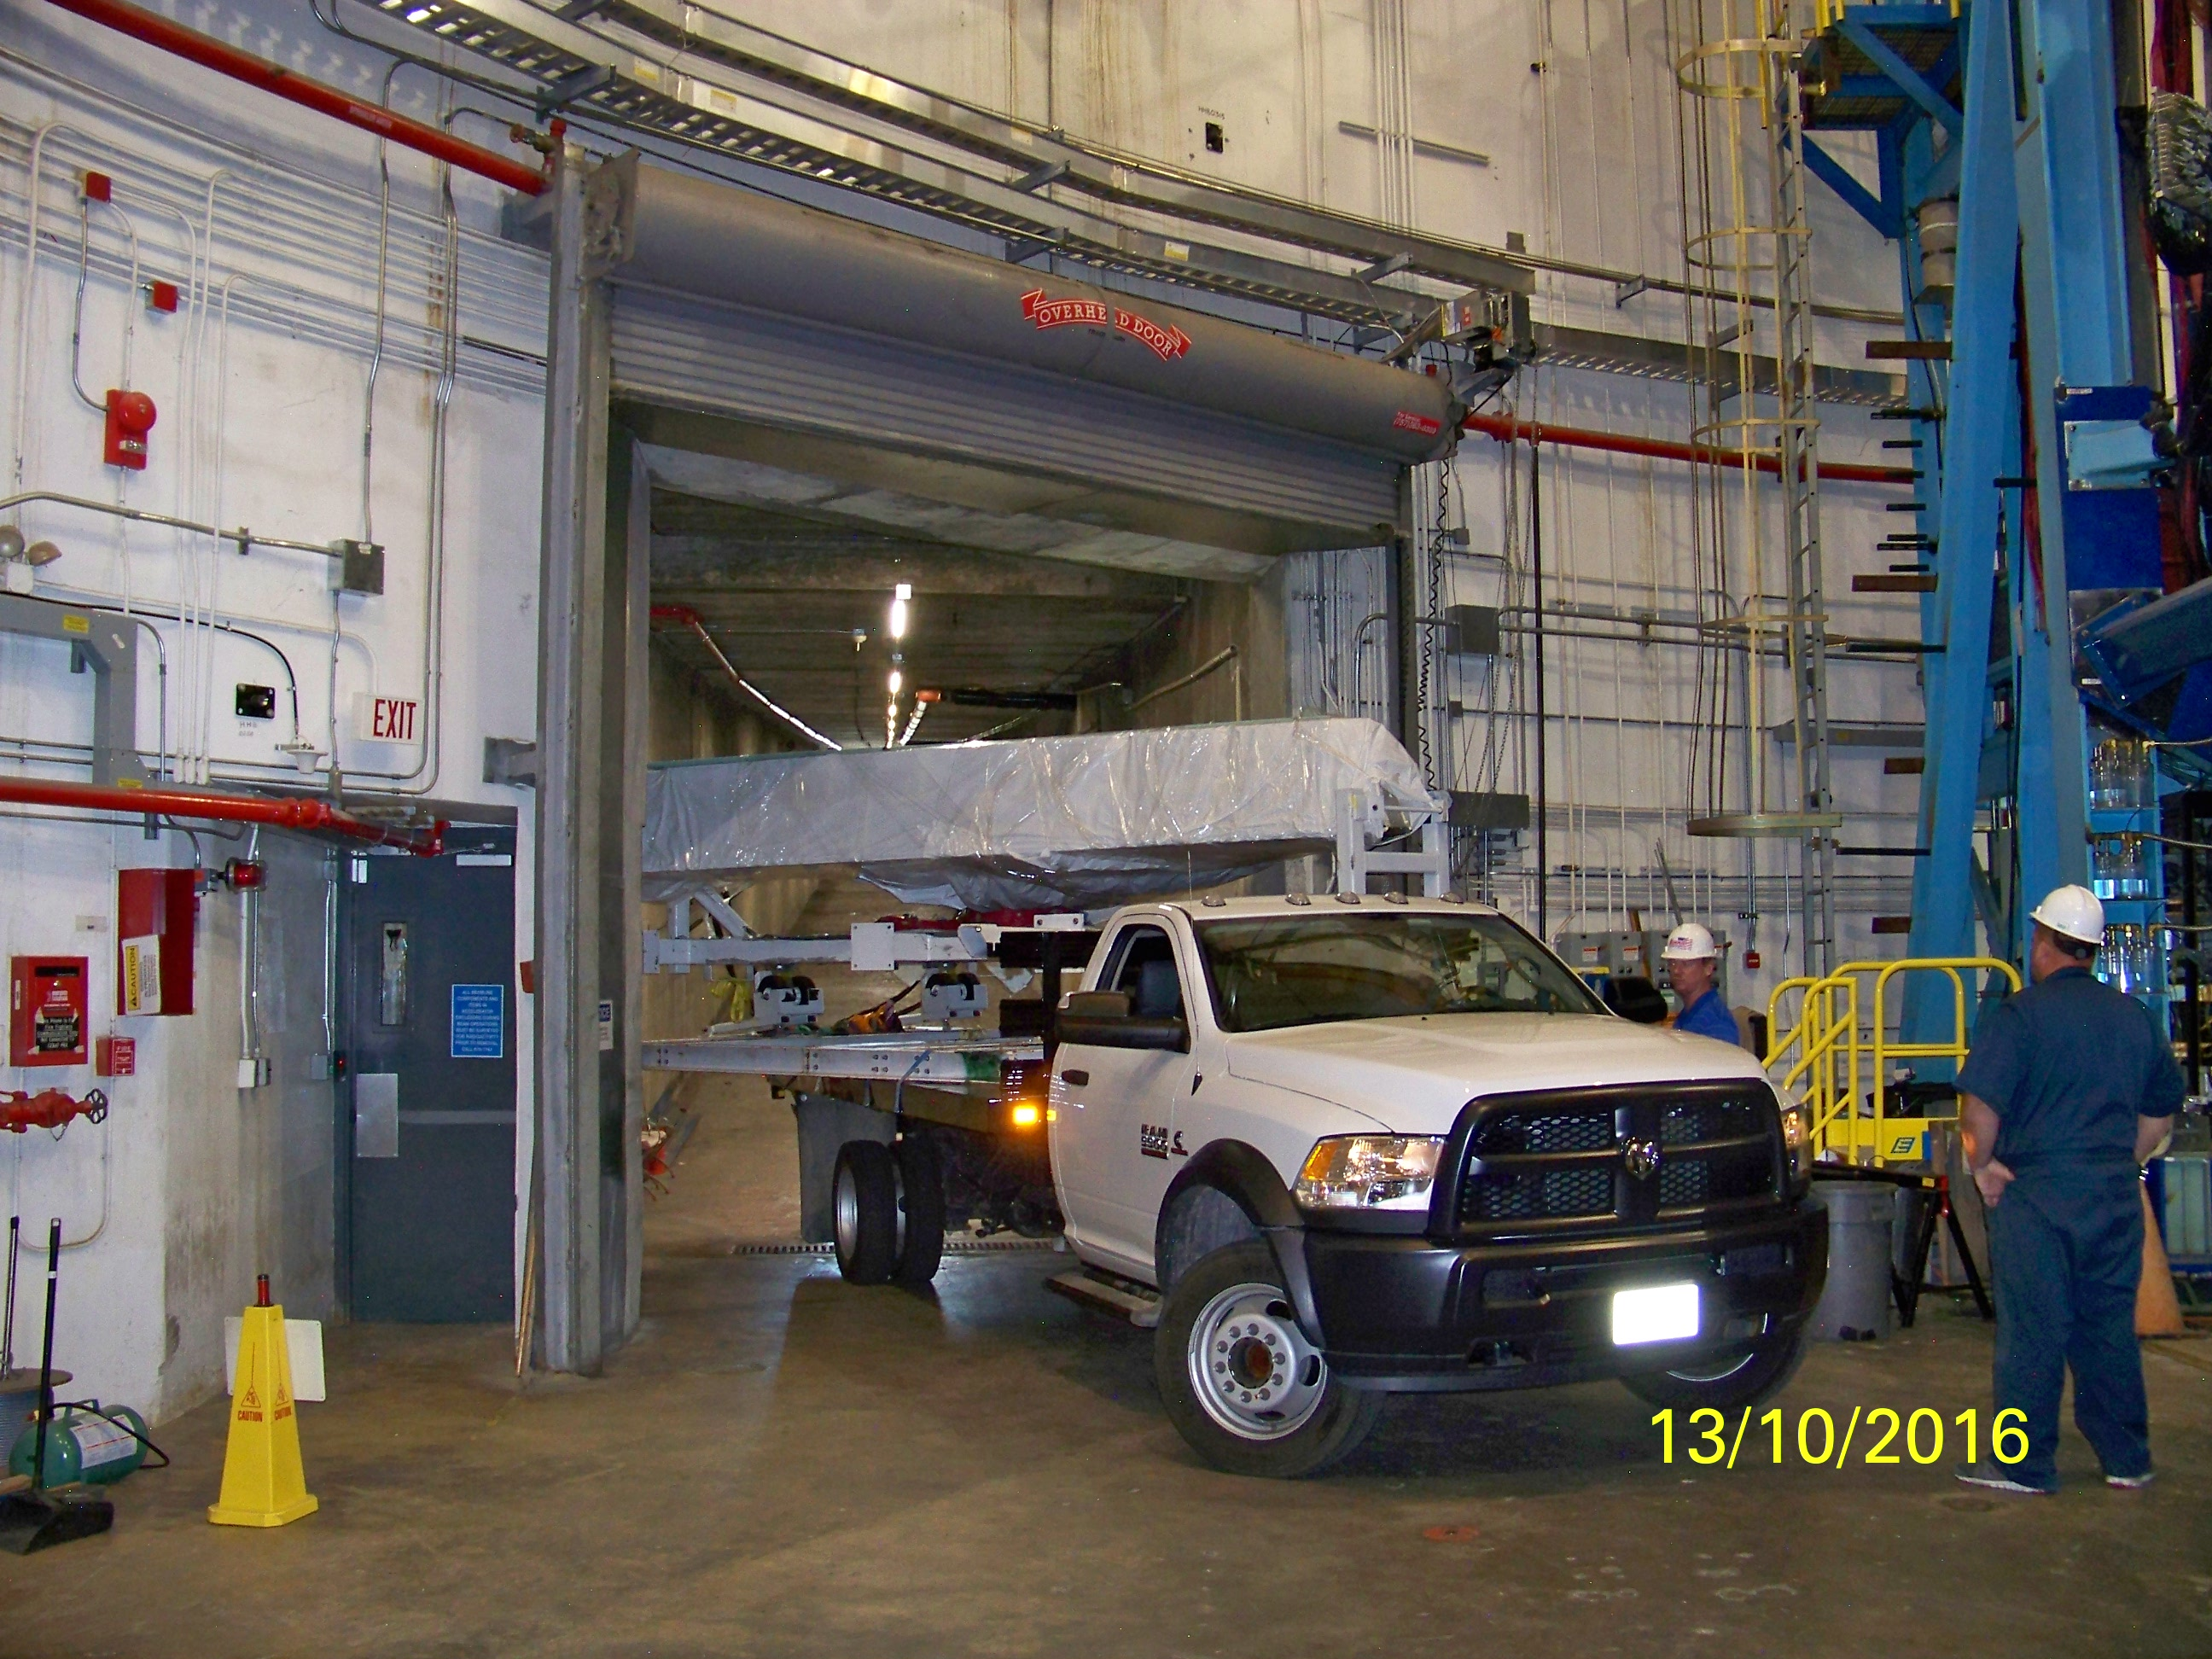
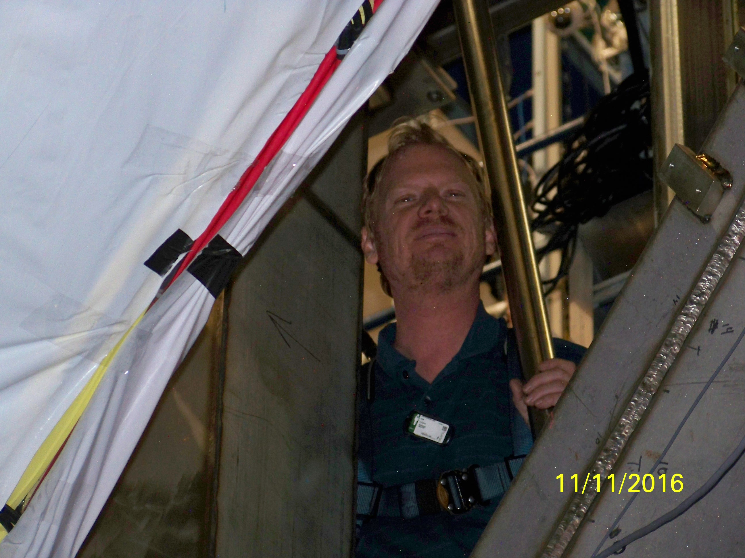
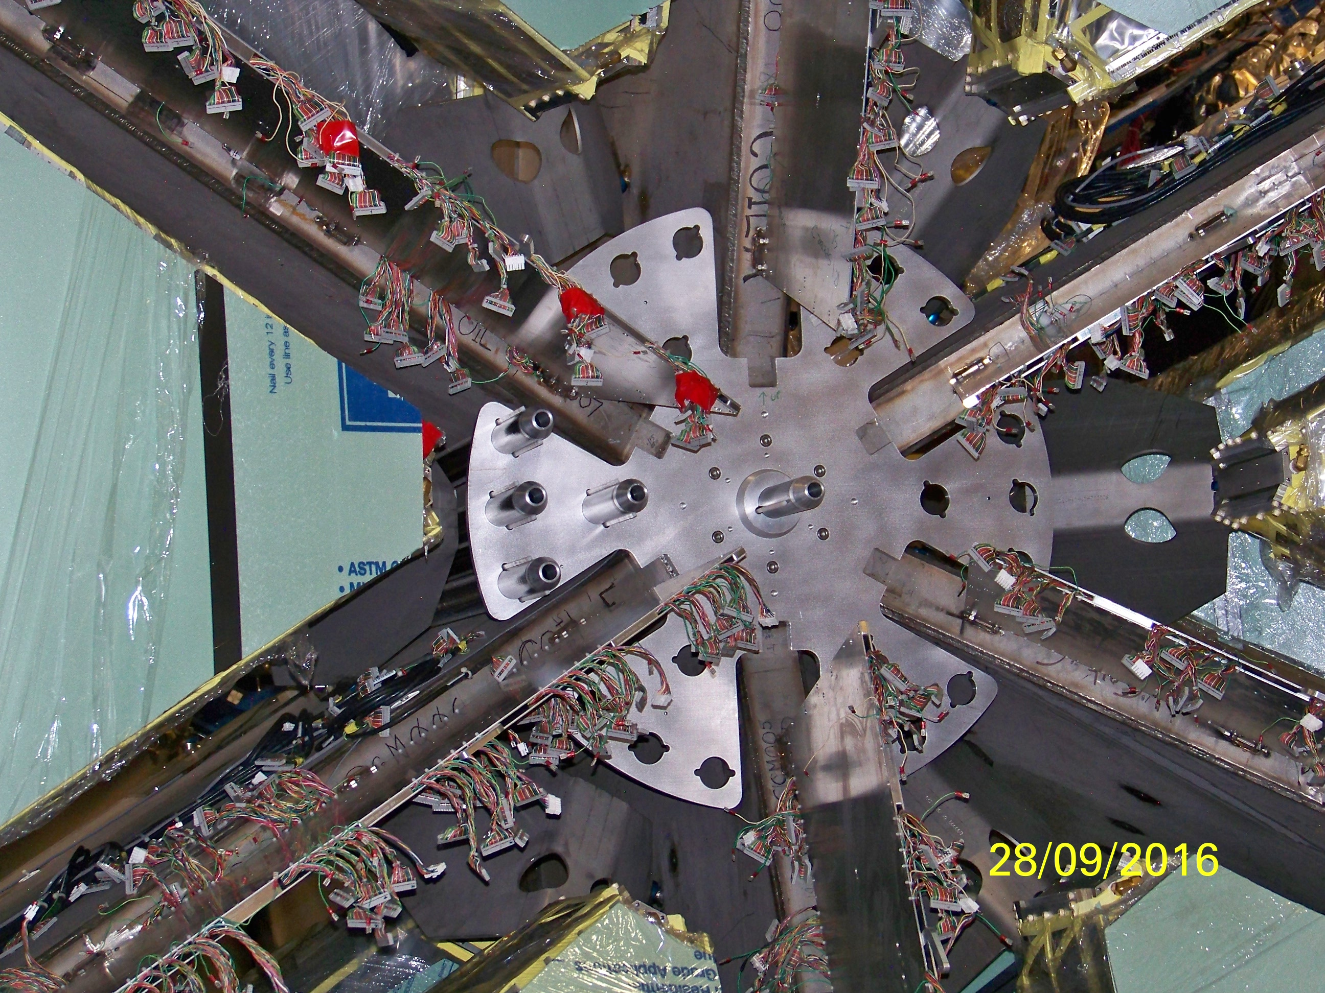
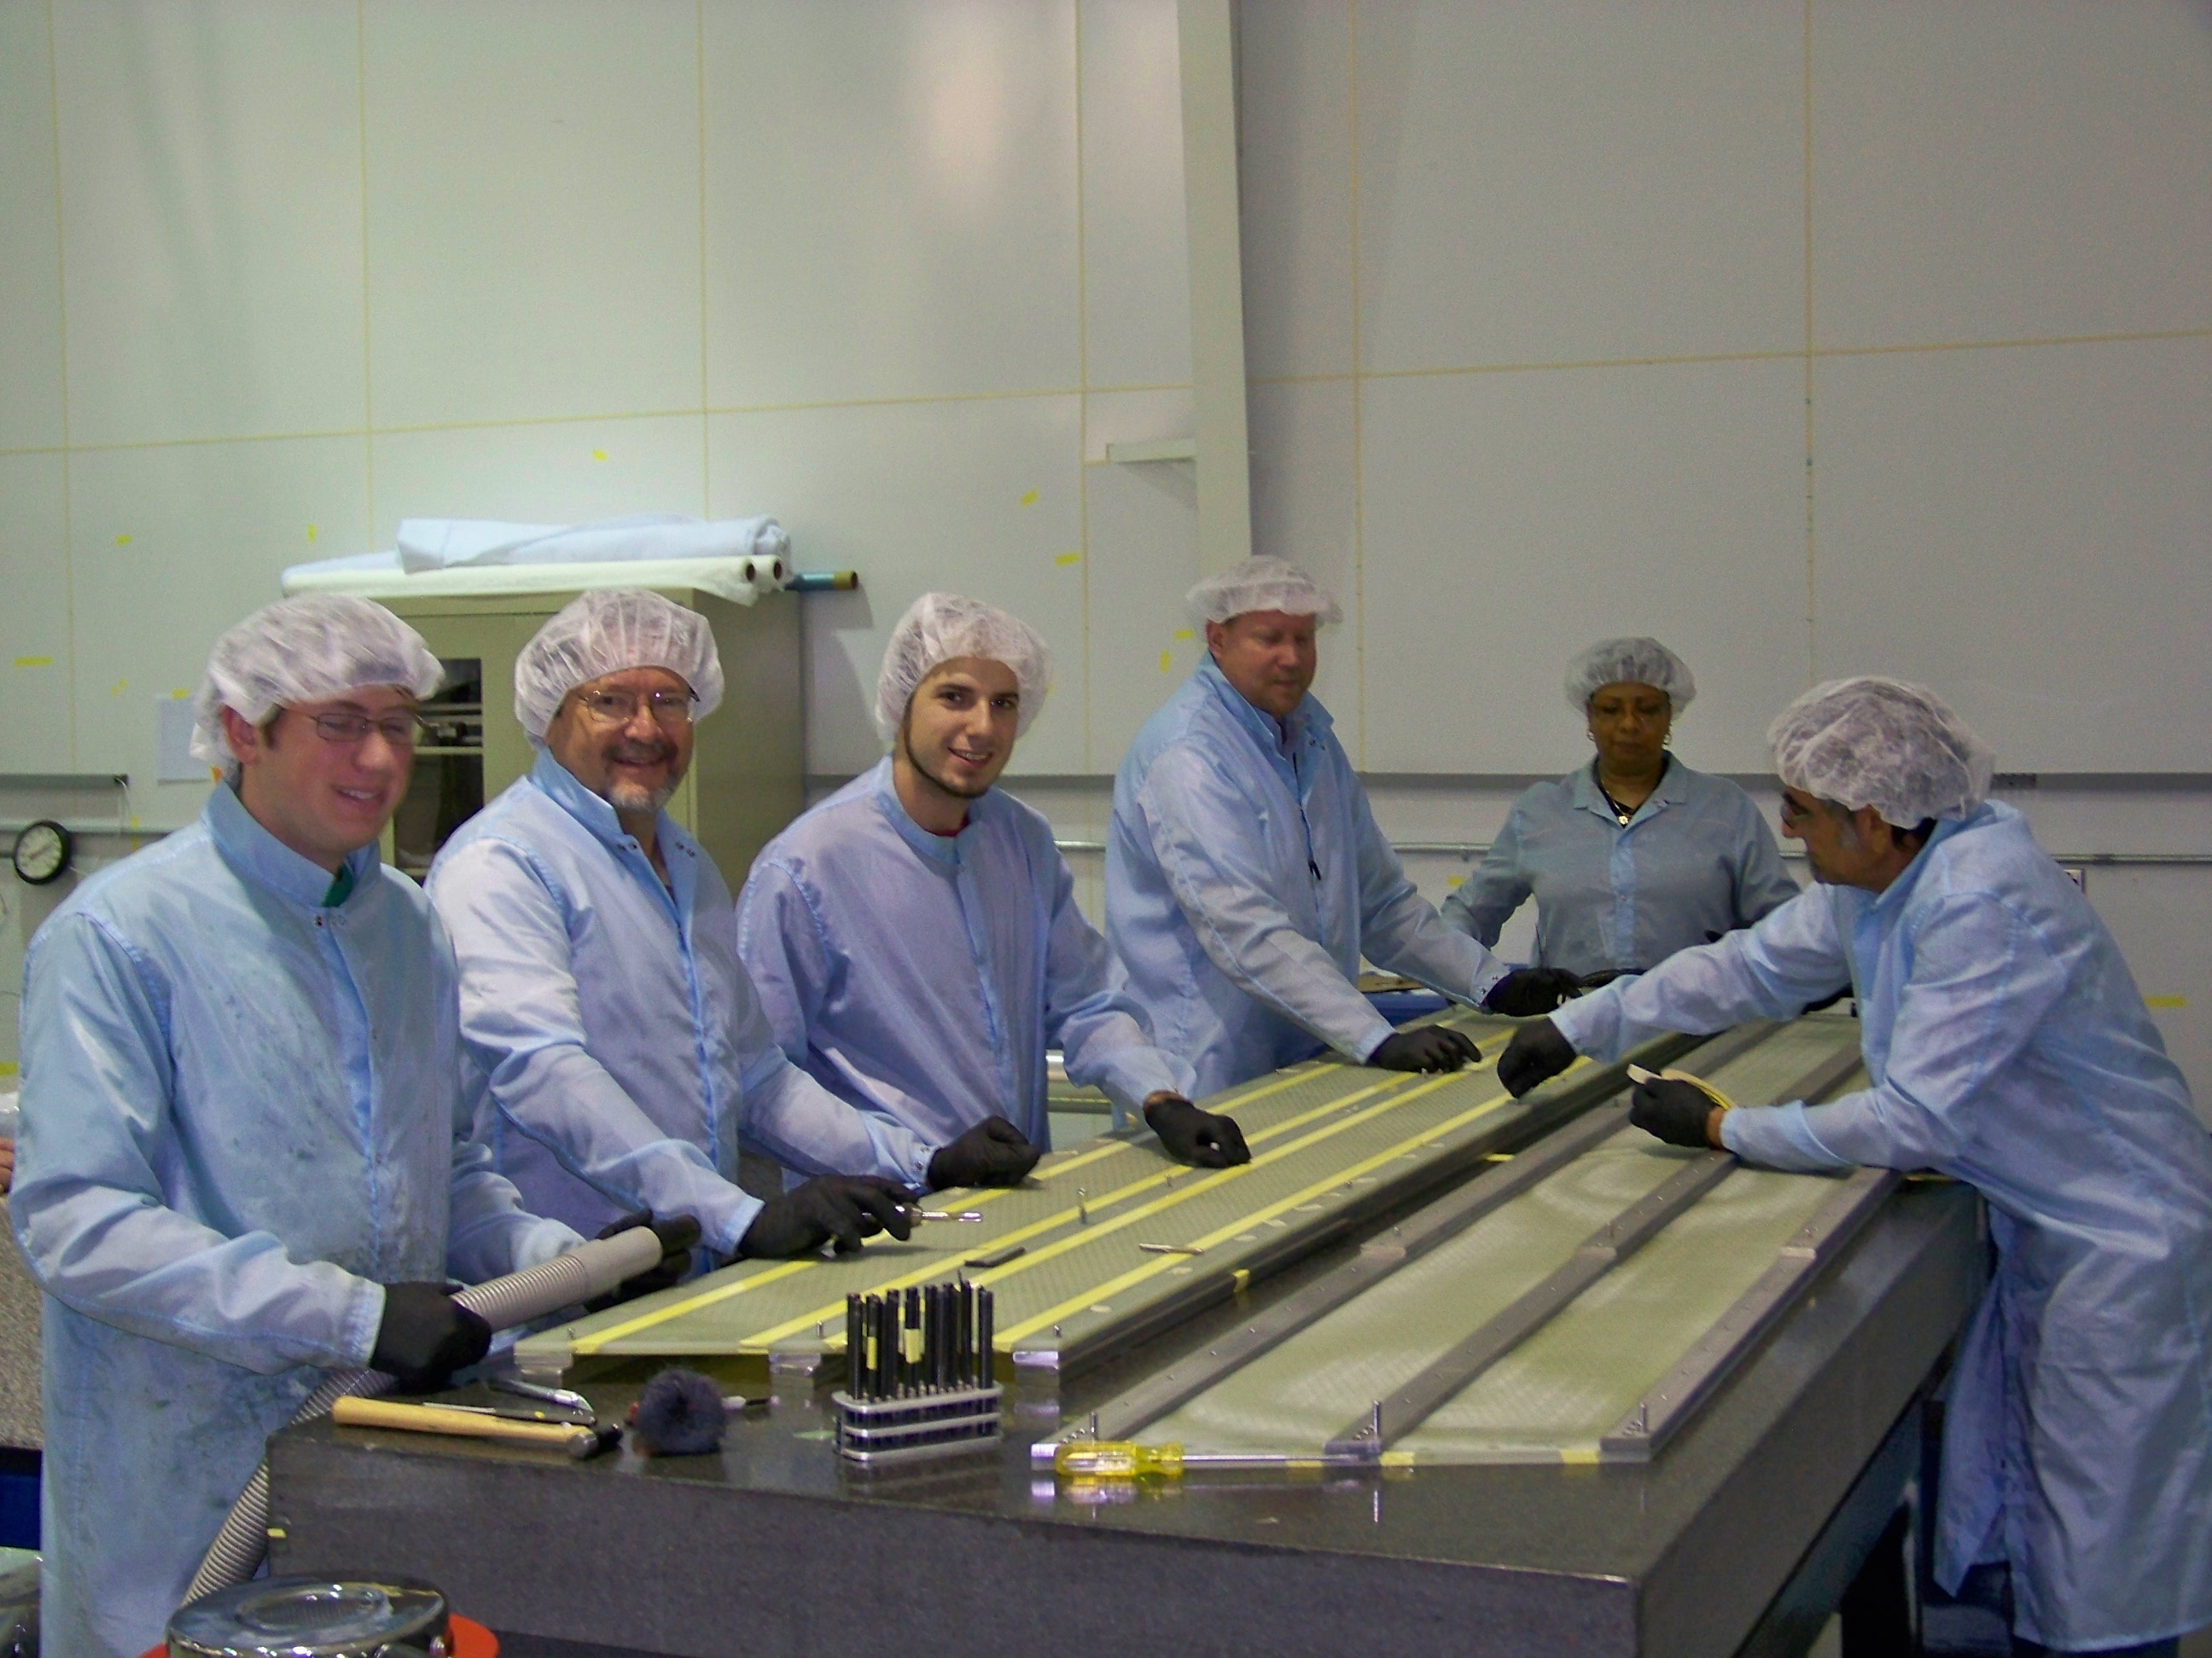
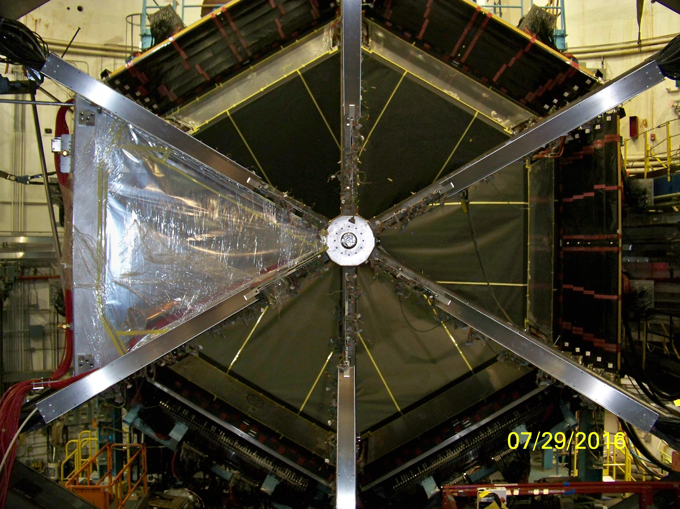
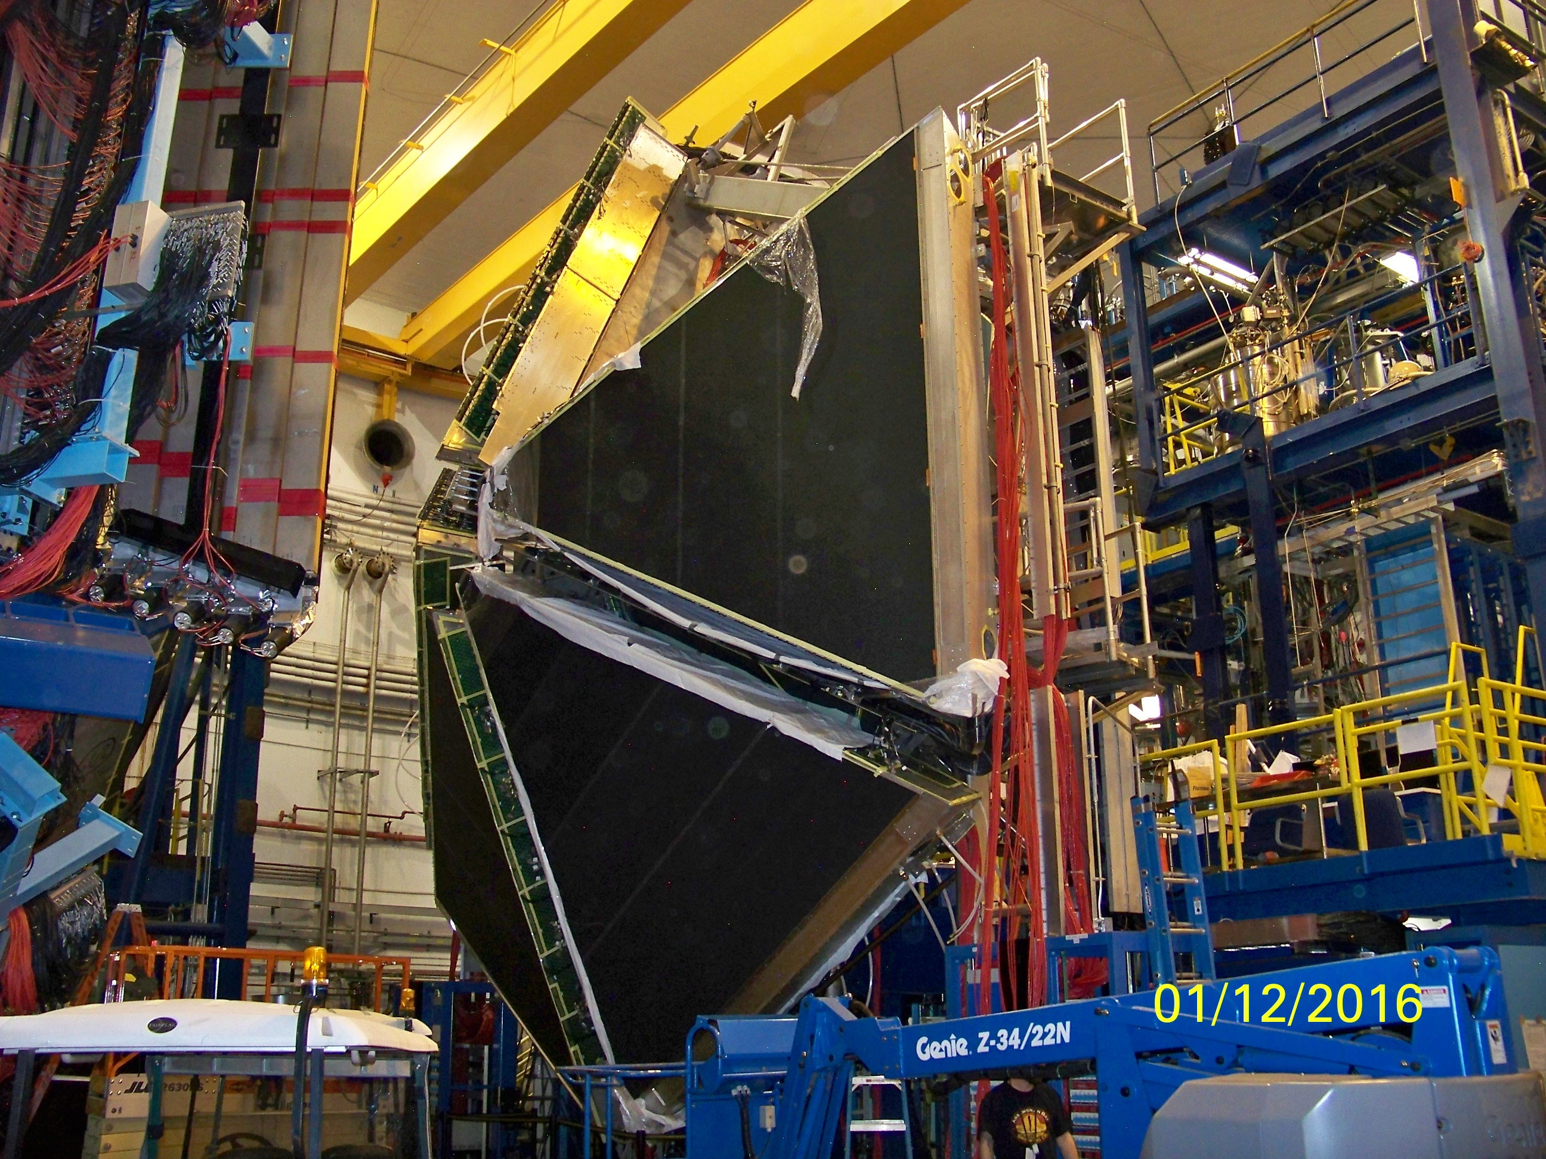
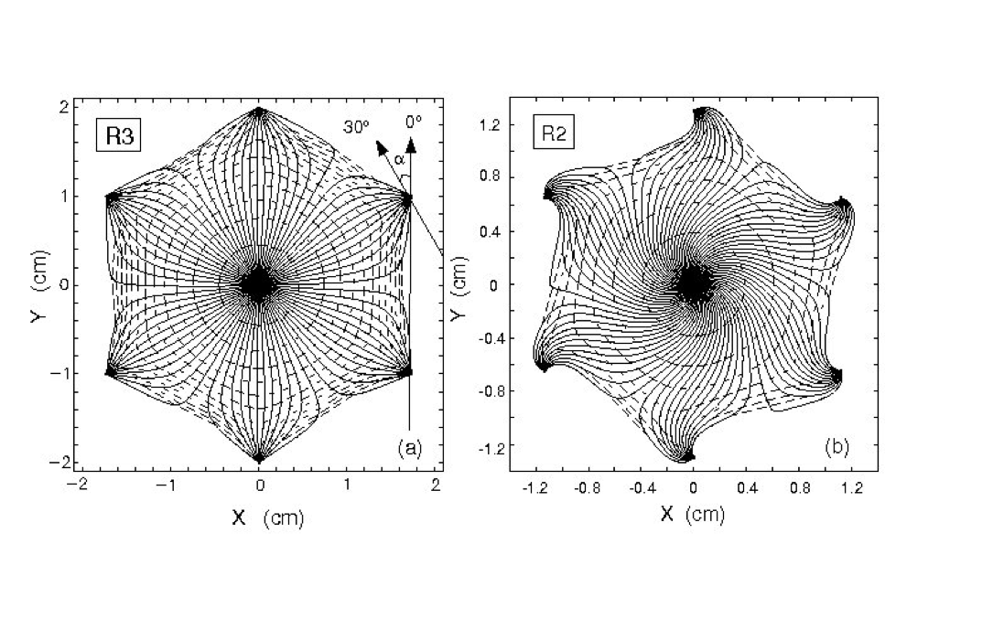
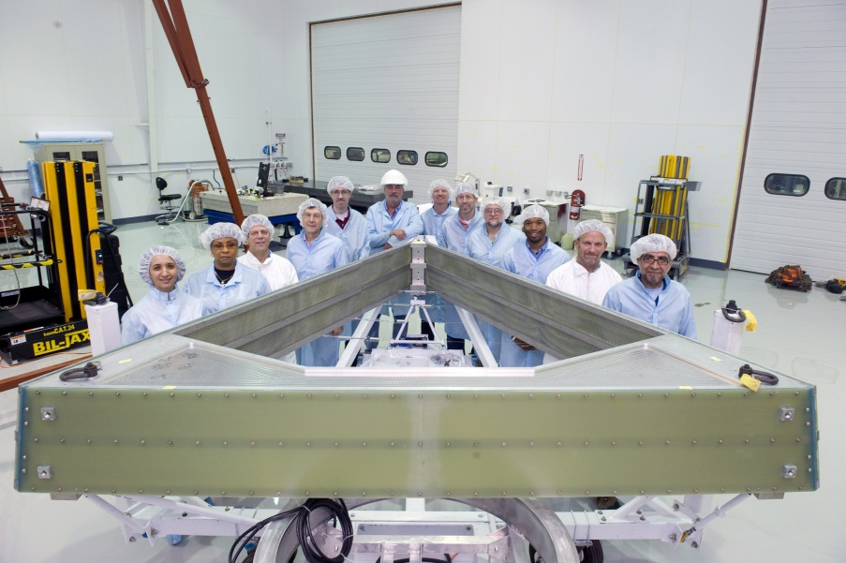
Drift Chambers (DC)
Thomas Jefferson National Accelerator Facility
What is it?
DC In Action
The Drift Chambers are used to determine:
The location of the nuclear collision generating the particles
The angle and direction of the particles
The momentum of the particles
When particles cross the drift chambers they knock electrons off the gas molecules. These electrons are accelerated, by an electric field produced by “field” wires, onto a “sense” wire and then to our electronics: the computer records this as a “hit”.
Dedicated software is used to process all the hits and reconstruct the path of the particle as it flies through the magnetic field. We determine its energy by how much it curves: the more it curves the lower the energy.
Torus
Magnetic Field
A representation of a single collision event taken in April 2018.
We collect about 10000 of these events every second.
You can see the trajectories of particles flying through the drift chambers.
The lines representing the particle trajectory as computed by our track reconstruction algorithms. The computer was able to identify one electron and two pions, one positive and one negative.
Notice that there is a a small amount of “background hits” which are real particles, but they are not associated with the beam-target interaction.
Sometimes we have a lot of background. The challenge for the software is to find the real tracks and reject the background.
Solenoid
Magnetic Field
electron
Negative
pion
Positive
pion
Region 1
Region 1
Region 2
Region 2
Region 3
Colors: Magnetic field strength
Region 3
Schematic of the Field (blue) and Sense (red) wires. The field wires produce an electric field that drives the electrons onto the sense wires. We use a pattern like this to reconstruct the particle momentum, direction and origin.
Our computer simulation of a particle flying through the drift chambers. We can calculate the particle momentum from its curvature in the magnetic field
Tech Specs
Cell type: Hexagonal
Wire layout: 6 sectors 3 regions
Stereo angle: +/- 6⁰ stereo
Position in CLAS12: Regions at 2, 3, 4m from the target
Granularity:
112 sense wires / layer (24192 total)
672 field wires / layer (145152 total)
Gas Choice: 90/10 Argon / CO₂
Angular resolution: 1 mrad or 0.057 degrees
Momentum resolution: less than 1%
Field and sense wires panel of one of our 18 chambers
Left Signal of a “real” track (green hits) and background noise (blue hits), in presence of low background. Right: high background event. Can you recognize the “real” tracks?
The spatial resolution of the DC is typically an outstanding 340 micrometers, or about one hundred of a inch.
Building and Installing the DC
Did you know?
The Drift Chambers cover a large area: more than 700 sq. ft.
The DC measure the position of particles to about 1/4 mm accuracy over this large area.
→ like a 1300 Mega-pixel camera !
The drift chamber electronics is capable of making a million measurements per second.
A typical modern smartphone camera takes a 12 Mega-pixel picture in one second. Given the resolution and speed, the Hall-B DC are the equivalent of 100 million smartphones.
There are 89,000 wires total, each one strung, tensioned and measured by hand.
3 teams of 5 technicians worked for ~ 2 years (here at JLab and at Old Dominion Univ. and at Idaho State University) to build and test the chambers.
Hall-B Technician does not fear heights while installing the Drift Chambers.
Hall-B Technician working on stringing, tensioning and measuring one out of 89,000 DC wires
Sir, there’s a package for you, can you sign here please? Yes it’s fragile.
One DC chamber being delivered in Hall-B.
Sector 6 DC Region 3 being installed in its final position
Our Hall-B lead engineer, Bob Miller, overseeing the Drift Chamber installation.
All 6 region 2 Drift Chambers installed between the torus coils. What an engineering achievement!
All but one DC chambers are installed. In this view, the back of region 3.
The electric field within the field wires. The sense wire is in the middle. The electrons travel along these field lines. It takes less than half a millionth of a second for the electrons to travel to the sense wires.
Contributing Institutions
Jefferson Lab, Newport News, VA, USA
Old Dominion University, Norfolk, VA, USA
Idaho State University, Pocatello, ID, USA
The very first DC region all packed up, installed in Hall-B. Do you know the feeling when you’re about to peel off that smartphone cover?
Scientists and Technicians posing with a Region 2 Drift Chamber.

